Slide 1
MICRO PROJECT 2024
DEEP NEURAL NETWROKS WITH PYTORCH – HAND WRITTEN RECOGNITION
RUKKAMOLLA SHASHIDHAR REDDY Reg.No: 99210041339 CSE II YEAR SLOT 3

Slide 2
AGENDA
Abstract
Introduction
Literature Survey
Proposed System Implementation
Experimental Analysis Conclusion References​
​

Slide 3
ABSTRACT
Handwriting recognition, also known as Optical Character Recognition (OCR), is the process of converting handwritten or printed text into machine-readable text.
In this project, we explore the use of logistic regression as a simple yet effective approach for recognizing handwritten characters.
We present a step-by-step methodology for data preprocessing, feature extraction, and model training, and evaluate the model's performance on a standard handwritten character dataset.
We are using pytorch framework to build and train the custom Logistic regression Model.

Slide 4
introduction
Handwritten recognition is a technology that holds immense promise in an era dominated by digital communication and data-driven applications.
From pytorch we are importing nn. module and created logistic regression custom model to train the MNIST Dataset.
The ability to accurately decipher handwritten content can streamline business operations, improve user experiences, and enhance data accessibility.
Variability in handwriting poses difficulties for traditional rule-based systems and demands more sophisticated approaches rooted in machine learning.

Slide 5
LITERATURE SURVEY
PAPER NAME & AUTHOR NAMES | DESCRIPTION
PAPER 1: D. Parkins, A. K. Nandi, "Genetic programming techniques for hand written digit recognition", 2004 | →In this paper they applied genetic programming to the recognition of hand written digits from the USPS data set. →According to authors knowledge, there have been no results presented on this data set using genetic programming.
PAPER 2: Mazin Al hadidi, Rami Salim rzouq, "Hand Written Digits Recognition Using Digital Learning Networks", 2012 | →A pattern recognition system based on the n-tuple technique is developed and evaluated for use in classifying non-deterministic data. →Particular reference to unconstrained hand-written numerals.

Slide 6
LITERATURE SURVEY
PAPER NAME & AUTHOR NAMES | DESCRIPTION
PAPER 3: A. lavanya, Ravi prakash, krishna, "Handwritten Digit Recognition Using Convolutional Neural Network", 2022 | →In the last few years, the area of fields where deep learning can be applied has increased vastly. →Stochastic gradient and backpropagation algorithms are used for training the network. For testing purposes, a forward algorithm is used.
PAPER 4: Yang Gong, Pan Zhang, "Research on Mnist Handwritten Numbers Recognition based on CNN", 2021 | →With the development of the times and social progress, more and more industries need to recognize handwritten digits. →For a long time in the past, due to the small workload, all recognition situations It is done mainly by human eyes.

Slide 7



PROPOSED SYSTEM
Dataset
MODEL
PREDICTION
Using famous dataset named MNIST.
Which is used in every where.
60000 – training images 10000 – testing images
Created custom Logistic Regression model with nn.module.
Trained with 50 epochs with Stochastic Gradient Descent Optimizer (SGD).
Prediction for testing images and custom images.
Prediction using our custom model with results indicated 87% accuracy.

Slide 8
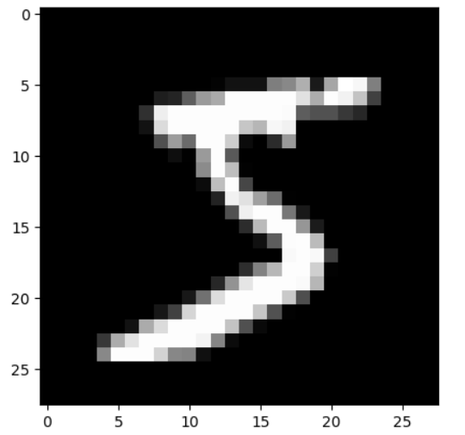
Implementation
DATA COLLECTION
SAMPLE IMAGE
The MNIST dataset is a widely used dataset in the field of machine learning and computer vision.
It contains 28x28 grayscale images of handwritten digits (0 to 9) and their corresponding labels.
The labels in MNIST are straightforward. Each image corresponds to a single digit, and the labels are integers from 0 to 9.

Slide 9
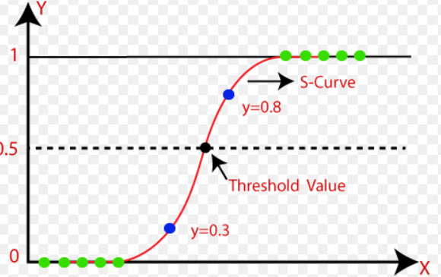
EXPERIMENTAL ANALYSIS
CLASSIFICATION
Logistic regression is primarily used for binary classification tasks, where the goal is to categorize data into two classes.
softmax approach to extend logistic regression for multi-class classification, making it a versatile choice.
Logistic regression is computationally efficient and straightforward to implement.

Slide 10
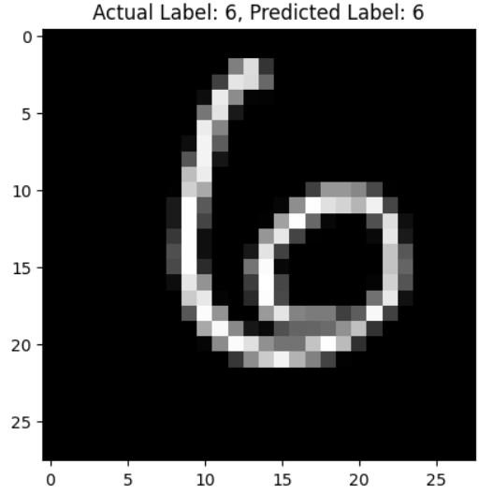
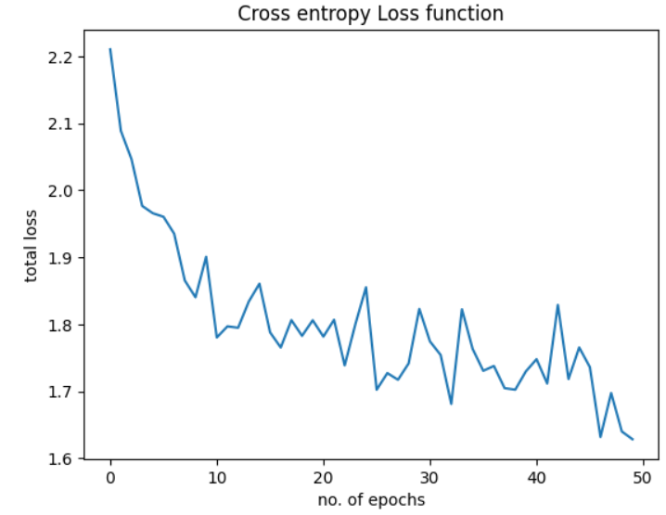
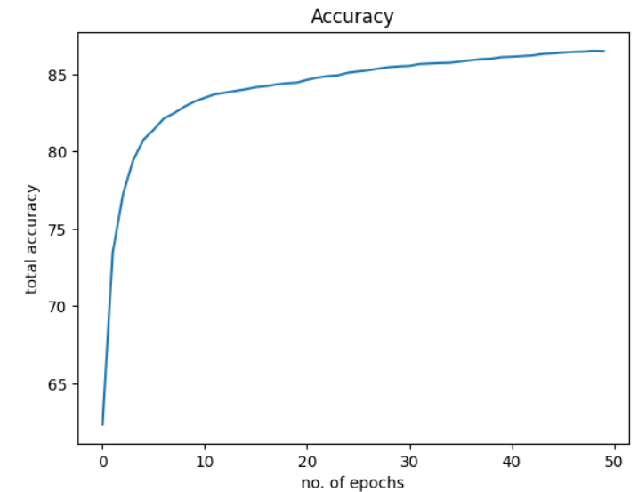
RESULTS VISUALIZATION
ACCURACY – 87%

Slide 11
CONCLUSION
In conclusion, hand-written recognition using PyTorch is a powerful and promising application of deep learning and neural networks. PyTorch provides a flexible and efficient platform for building and training models for this task. Leveraging convolutional neural networks (CNNs) and recurrent neural networks (RNNs). While it demands significant data preprocessing, model architecture design, and training, the results can be highly accurate and beneficial across various domains, including finance, healthcare, and education. The ongoing advancements in deep learning and PyTorch's active development community ensure that hand-written recognition using PyTorch will continue to advance, making it an exciting field for further research and application.

Slide 12
REFERENCES
→A. D. Parkins, A. K. Nandi, "Genetic programming techniques for hand written digit recognition", 2004
doi:https://doi.org/10.1016/j.sigpro.2004.07.027
→Mazin Al hadidi, Rami Salim rzouq, "Hand Written Digits Recognition Using Digital Learning Networks", 2012
doi:https://doi.org/10.1016/j.ieri.2012.06.103
→A. lavanya, Ravi prakash, krishna, "Handwritten Digit Recognition Using Convolutional Neural Network", 2022, www.jeitr.com(ISSN-2349-5162)
→Yang Gong, Pan Zhang, "Research on Mnist Handwritten Numbers Recognition based on CNN", 2021
doi:https://doi.org/10.1088/1742-6596/2138/1/012002
→Shapna Akter, Hossain Shahriar, Nova Ahmed, "Handwritten Word Recognition using Deep Learning Approach: A Novel Way of Generating Handwritten Words", 2023

